Slide 1

AUCTION SPHERE – ONLINE AUCTION PLATFORM
Presented by:
B.NITHIN (22E11A6672)
B.SARAYU (22E11A6673)
M.RAKESH (22E11A6697)
Under the guidance of
Mrs Syeda Hafsa Naaz
Assistant Professor
Department of CSE(AI&ML)

Slide 2
Outline
ABSTRACT
INTRODUCTION
LITERATURE REVIEW
OBJECTIVE
FUNCTIONAL LAYOUT
METHODOLOGY
IMPLEMENTATION
RESULTS/WORKING
REFERENCES

Slide 3
Abstract
AuctionSphere is a modern online auction platform designed to enable secure, transparent, and real-time bidding between buyers and sellers over the web. The platform allows users to list products for auction, place competitive bids, track live auction status, and receive instant notifications about bid updates and auction results. Unlike traditional fixed-price e-commerce systems, AuctionSphere emphasizes dynamic pricing, encouraging fair market value through competitive bidding.
The system includes core functionalities such as user authentication, product listing management, real-time bidding, auction scheduling, and winner determination. Advanced features like bid history tracking, automated bid validation, anti-sniping mechanisms (time extensions for last-second bids), and secure payment integration ensure reliability and trust. The backend manages auction logic, bid consistency, and data security, while the frontend delivers an intuitive and responsive user experience.
AuctionSphere can be deployed on cloud infrastructure to support scalability and high availability, making it suitable for real-world use cases such as art auctions, collectibles, used goods, government tenders, and online marketplaces. The project demonstrates strong practical skills in full-stack development, database design, and real-time system handling.

Slide 4
Introduction
Traditional auctions require physical presence and limited participation.
Online auction systems allow users from different locations to participate.
This project aims to develop a secure and efficient web-based auction system.
It provides features like:
Product listing
Live bidding
Auction timer
Bid tracking
User authentication
The system ensures transparency and fair competition among bidders.

Slide 5
Literature Survey
Ref. No | Title & Author | Technique Used | Pros | Cons
1 | Online Auction System – Smith J., 2020 | Web-based auction system using real-time bidding algorithms | Enables online participation, dynamic pricing | Limited security mechanisms
2 | Secure E-Auction Framework – Kumar R., 2021 | Secure authentication and encrypted bidding system | Improves data security and trust | Higher implementation complexity
3 | E-Commerce Auction Platform – Lee S., 2019 | Cloud-based auction platform with centralized database | Scalable and accessible from anywhere | Depends on stable internet connection
4 | Real-Time Online Bidding System – Ahmed K., 2022 | Real-time bid update using server-client architecture | Instant bid updates and improved user engagement | Requires strong server performance
5 | Blockchain Based Auction System – Zhang Y., 2023 | Blockchain technology for transparent bidding | High transparency and tamper-proof records | High computational cost and complexity

Slide 6
Literature Survey
Ref. No | Title & Author | Technique Used | Pros | Cons
6 | Online Auction System Based on Web Technology – Zhang et al., 2019 | Web-based auction system using client–server architecture and database management | Easy accessibility, supports online bidding from anywhere | Security risks if authentication is weak
7 | Online Auction System Based on Web Technology – Zhang et al., 2019 | Web-based auction system using client–server architecture and database management | Easy accessibility, supports online bidding from anywhere | Security risks if authentication is weak
8 | Online Auction System Based on Web Technology – Zhang et al., 2019 | Web-based auction system using client–server architecture and database management | Easy accessibility, supports online bidding from anywhere | Security risks if authentication is weak
9 | Online Auction System Based on Web Technology – Zhang et al., 2019 | Web-based auction system using client–server architecture and database management | Easy accessibility, supports online bidding from anywhere | Security risks if authentication is weak

Slide 7
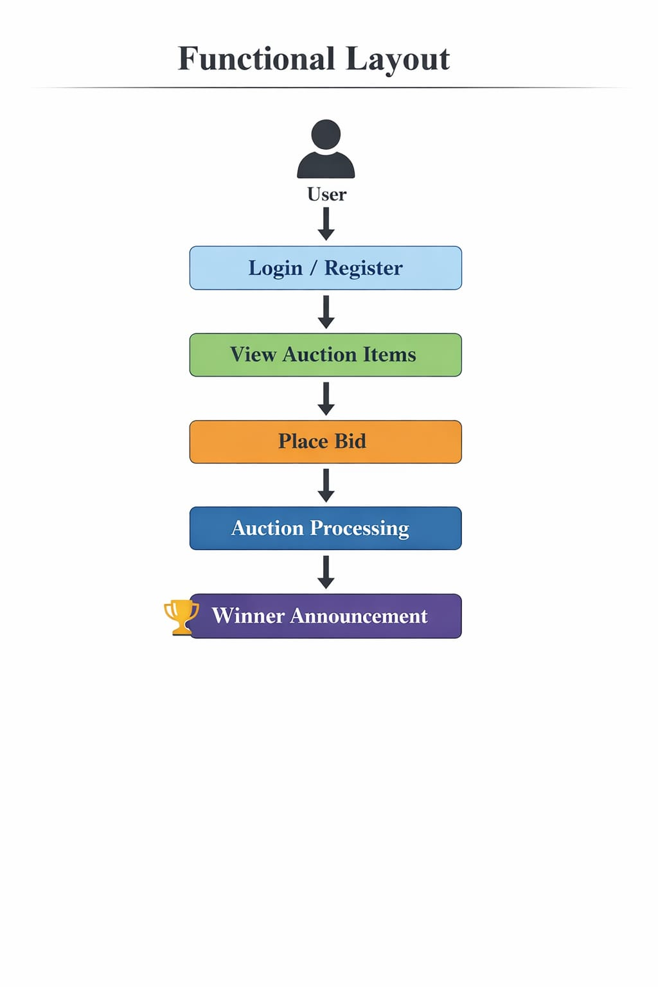
Functional Layout

Slide 8
Objective
To design and develop a secure and user-friendly online auction platform that allows users to participate in auctions through the internet.
To enable real-time bidding where multiple users can place bids on products and view live bid updates.
To provide a transparent auction process by displaying bid history and auction status to all participants.
To implement secure user authentication and authorization to protect user data and transactions.
To automate the winner selection process based on the highest bid when the auction time ends.
To create a scalable and efficient system that supports multiple users and auctions simultaneously.

Slide 9
Methodology
1. Requirement Analysis
The first step was to analyze the requirements of an online auction system. The system should allow users to register, login, create auctions, place bids, and determine the highest bidder when the auction ends.
2. System Design
The system architecture was designed using a client–server model. The frontend handles user interaction while the backend processes auction logic and database operations.
3. Database Design
A database schema was designed to store system data efficiently. The main tables include User, Auction, and Bid, which store user details, auction information, and bid records.
4. Development
The system was implemented using Python Flask for backend development and HTML, CSS, and Bootstrap for frontend design. SQLAlchemy ORM was used to interact with the SQLite database.
5. Testing
The application was tested to ensure correct functionality such as user authentication, auction creation, bid validation, and winner selection after auction completion.
6. Deployment
Finally, the application was deployed on the Render cloud platform, allowing users to access the auction system online through a web browser.

Slide 10
Implementation
1. Components and Specifications
Hardware: Minimum i5/i7 processor, 8–16 GB RAM, Stable Internet Connection.
Software: Python Flask framework for backend development, HTML, CSS, and Bootstrap for frontend design, SQLite database for data storage, Visual Studio Code for coding and development, GitHub for version control and project management.
2. Coding
Frontend developed using HTML, CSS, and Bootstrap to create responsive web pages for user interaction. Backend implemented using Python Flask to manage application logic such as user authentication, auction creation, and bidding operations. Flask-Login is used for session management and SQLAlchemy ORM is used for database interaction.
3. Application
Backend: Flask routes process user requests such as registration, login, auction creation, and bid submission. Data is stored and retrieved from the SQLite database.
Frontend: Web interface allows users to register, login, create auctions, upload product images, and place bids on available auctions.
4. Integration
The frontend interface communicates with the backend Flask server through HTTP requests. Database operations are handled using SQLAlchemy to ensure efficient storage and retrieval of auction and bid data. The application is deployed on the Render cloud platform, allowing users to access the system online through a web browser.

Slide 11
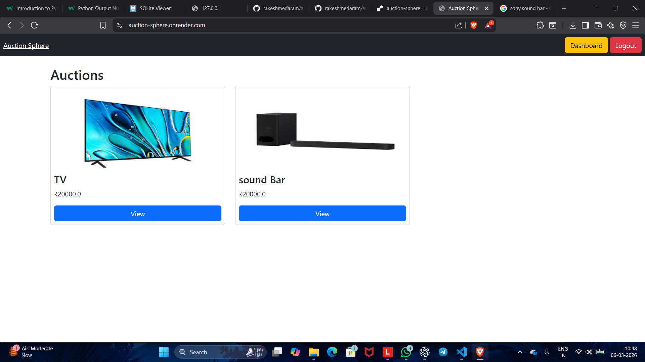
Results/Working

Slide 12
Conclusion & Future Scope
Conclusion
The Auction Sphere – Online Auction System successfully provides a platform where users can create auctions, place bids, and determine winners automatically. The system simplifies the traditional auction process by providing a secure, transparent, and user-friendly web application.
The project demonstrates the use of modern web technologies such as Flask, HTML, CSS, and SQLite to develop a full-stack application. It enables efficient management of auctions, real-time bidding, and secure user authentication.
Overall, the system improves accessibility and allows users to participate in auctions from anywhere using an internet connection.
Future Scope
• Implement real-time bidding updates using WebSockets for instant bid notifications.
• Integrate online payment gateways such as Razorpay or Stripe for secure transactions.
• Add email or SMS notifications for auction winners and bid updates.
• Enhance the user interface with advanced UI frameworks for a better user experience.
• Improve system scalability by integrating cloud databases and advanced security mechanisms.

Slide 13
References (APA Style)
Fielding, R. T. (2000). Architectural styles and the design of network-based software architectures. University of California, Irvine.
Grinberg, M. (2018). Flask web development: Developing web applications with Python (2nd ed.). O’Reilly Media.
Elmasri, R., & Navathe, S. B. (2016). Fundamentals of database systems (7th ed.). Pearson Education.
Krishnamurthy, B., & Rexford, J. (2001). Web protocols and practice: HTTP/1.1, networking protocols, caching, and traffic measurement. Addison-Wesley.
Kurose, J. F., & Ross, K. W. (2017). Computer networking: A top-down approach (7th ed.). Pearson.
Flask Documentation. (2024). Flask web framework. Retrieved from https://flask.palletsprojects.com/
Render Documentation. (2024). Deploying web applications on Render. Retrieved from https://render.com/docs

Slide 14
THANK YOU

